Slide 1

Notes:
Original slide 1 preserved as provided. Present this slide first, then use the following explanation slide as your speaking support.

Slide 2
Slide 1 — Explanation
How to Introduce the Project
Reference slide kept unchanged
Frame it as a supervised, multiclass ML system — not just a model.
• Goal: convert lab-measured soil values into Low, Medium or High fertility.
• Inputs: 12 soil properties such as N, P, K, pH, EC, OC and micronutrients.
• Scope: Dataset → EDA → Decision Tree → Random Forest → Flask prediction app.
Quick structure to speak
1. State the purpose
2. Explain the method
3. Justify why it fits
4. Mention the limitation
Say this in viva / presentation
“This project learns a mapping from soil parameters to one of three fertility classes.”
Tip: Do not just read the slide. Use the slide as proof, then explain the reasoning in your own words.
Notes:
Start by saying that the project is Soil Quality Classification using Decision Tree and Random Forest. It is supervised because each training sample already has a known fertility label. It is multiclass because the output can be Low, Medium or High. Emphasize that the project is end-to-end: it begins with a CSV dataset, performs EDA, trains models, and exposes predictions through a Flask web app.

Slide 3
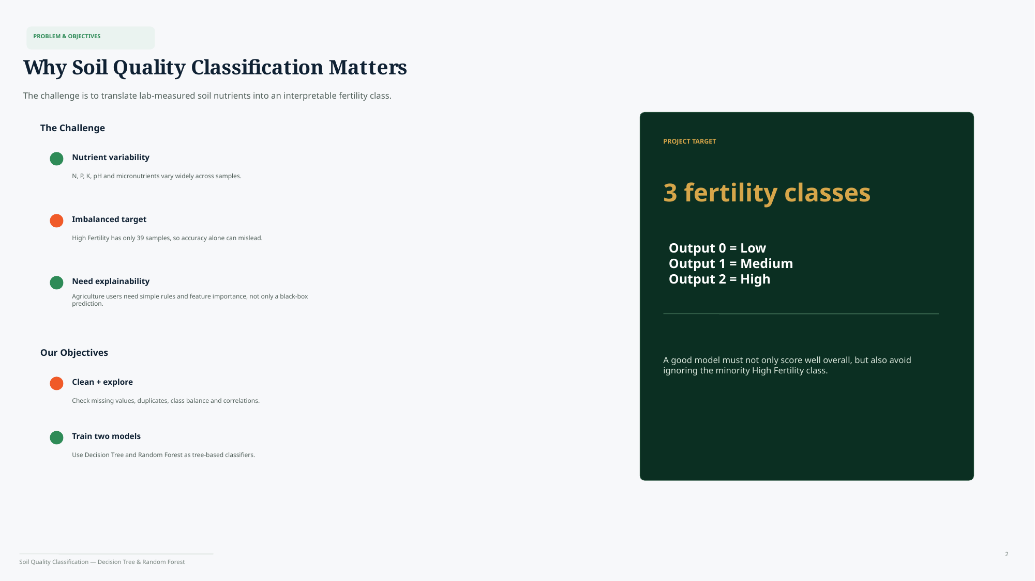
Notes:
Original slide 2 preserved as provided. Present this slide first, then use the following explanation slide as your speaking support.

Slide 4
Slide 2 — Explanation
Problem + Objectives
Reference slide kept unchanged
The real problem is making soil-test numbers understandable and actionable.
• Nutrients vary widely, so fertility cannot be judged from one value alone.
• High fertility has only 39 samples, so accuracy alone can give a false sense of success.
• Agriculture users need simple rules and feature importance, not only a black-box label.
Quick structure to speak
1. State the purpose
2. Explain the method
3. Justify why it fits
4. Mention the limitation
Say this in viva / presentation
“A good model should perform well overall and also avoid ignoring the rare High Fertility class.”
Tip: Do not just read the slide. Use the slide as proof, then explain the reasoning in your own words.
Notes:
Explain that lab tests produce numerical values, but users want an interpretable fertility class. The challenges are nutrient variability, class imbalance, and explainability. Class imbalance is important because Low and Medium classes have hundreds of examples, while High has only 39. A model can appear accurate by mostly predicting the majority classes, so we need macro metrics and per-class understanding.

Slide 5
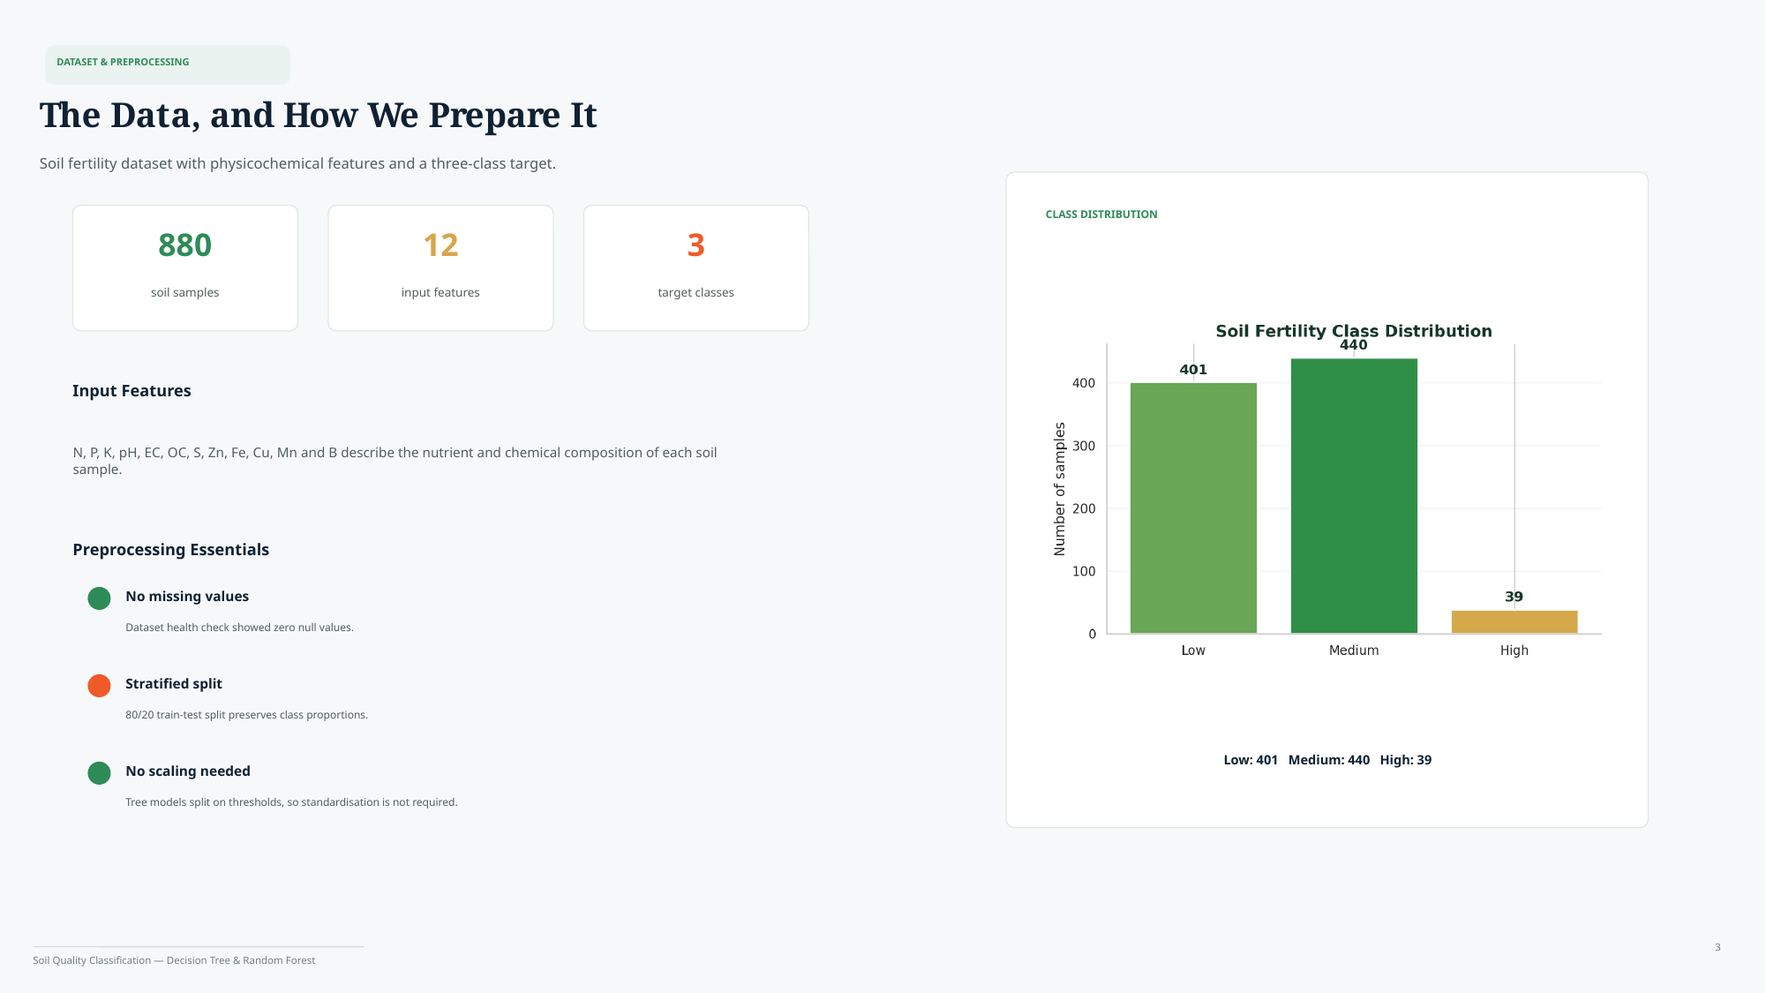
Notes:
Original slide 3 preserved as provided. Present this slide first, then use the following explanation slide as your speaking support.

Slide 6
Slide 3 — Explanation
Dataset + Preprocessing
Reference slide kept unchanged
This is a clean tabular dataset, but the target distribution is imbalanced.
• Dataset: 880 samples, 12 input features and 3 target classes.
• Features cover primary nutrients, pH/EC/OC and micronutrients like Zn, Fe, Cu, Mn and B.
• Preprocessing: zero nulls, stratified 80/20 split, and no scaling because tree models use thresholds.
Quick structure to speak
1. State the purpose
2. Explain the method
3. Justify why it fits
4. Mention the limitation
Say this in viva / presentation
“Stratified splitting was necessary because the High class is very small.”
Tip: Do not just read the slide. Use the slide as proof, then explain the reasoning in your own words.
Notes:
Mention that preprocessing is not only fixing problems; checking and confirming data quality is also preprocessing. There were no missing values, so imputation was not needed. Stratified 80/20 split preserves the same class ratio in train and test sets. Scaling is not required for Decision Trees and Random Forests because they compare thresholds such as N less than a value instead of computing distances.

Slide 7
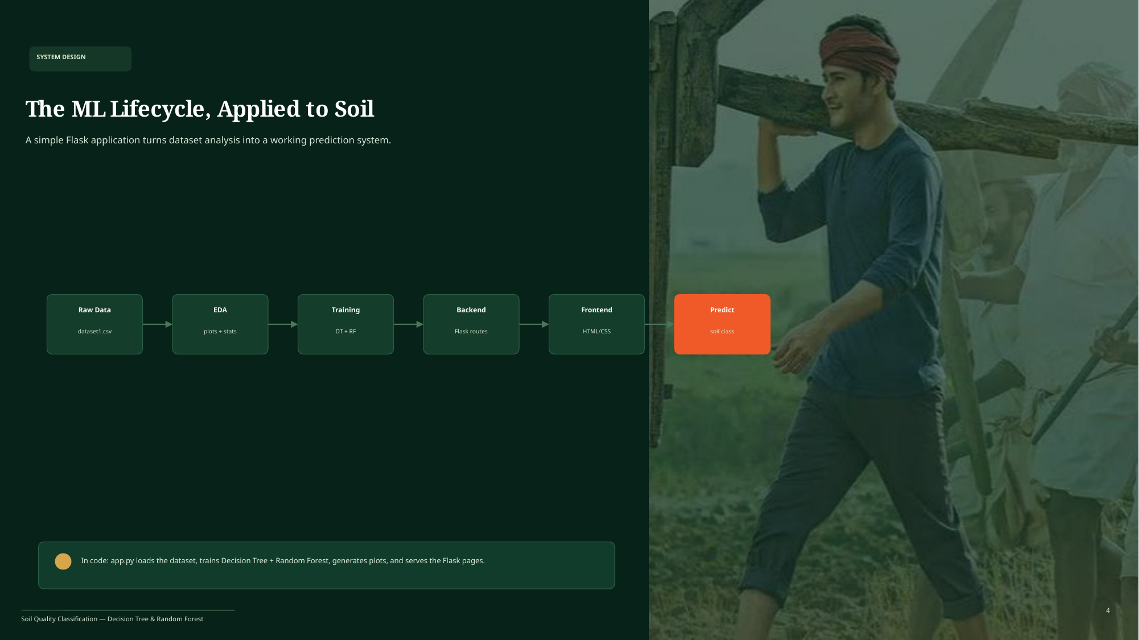
Notes:
Original slide 4 preserved as provided. Present this slide first, then use the following explanation slide as your speaking support.

Slide 8
Slide 4 — Explanation
ML Lifecycle Applied to Soil
Reference slide kept unchanged
This slide shows how the notebook work becomes a usable prediction system.
• Raw data starts as dataset1.csv, then EDA produces plots and statistics.
• Training builds two models: Decision Tree and Random Forest.
• Flask connects backend routes, HTML/CSS pages and the final user-facing prediction.
Quick structure to speak
1. State the purpose
2. Explain the method
3. Justify why it fits
4. Mention the limitation
Say this in viva / presentation
“I did not stop at analysis; I served the trained models through a small Flask application.”
Tip: Do not just read the slide. Use the slide as proof, then explain the reasoning in your own words.
Notes:
Walk through the pipeline from left to right: raw CSV, EDA, training, backend, frontend, prediction. Tie it to the ML lifecycle from the subject: raw data, cleaned data, trained model, served endpoint, and user-facing output. Explain that app.py loads the dataset, trains models, creates analysis outputs, and serves the Flask pages.

Slide 9
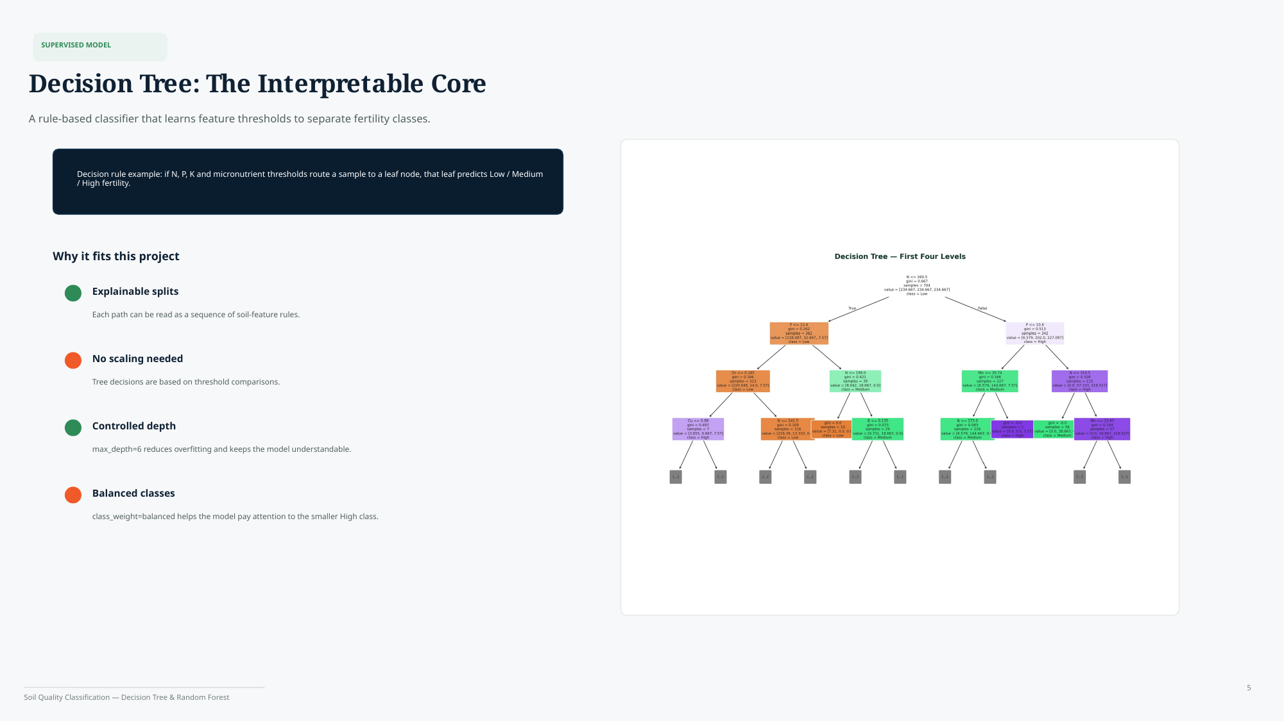
Notes:
Original slide 5 preserved as provided. Present this slide first, then use the following explanation slide as your speaking support.

Slide 10
Slide 5 — Explanation
Decision Tree Explanation
Reference slide kept unchanged
A Decision Tree is useful because every prediction can be read like if–else rules.
• At each node, the tree chooses the feature threshold that best separates classes.
• A sample follows a path through the tree until it reaches a leaf node prediction.
• max_depth=6 controls overfitting; class_weight=balanced gives more importance to minority class errors.
Quick structure to speak
1. State the purpose
2. Explain the method
3. Justify why it fits
4. Mention the limitation
Say this in viva / presentation
“The Decision Tree is my interpretable baseline because each path is a readable rule sequence.”
Tip: Do not just read the slide. Use the slide as proof, then explain the reasoning in your own words.
Notes:
Explain using a simple example: if nitrogen is below a threshold, go left; otherwise go right. The tree repeatedly chooses splits that create purer groups. A pure group mostly contains one class. max_depth=6 prevents the tree from memorizing the training data. class_weight balanced is used because the High class is small, so mistakes on that class should matter more during training.

Slide 11
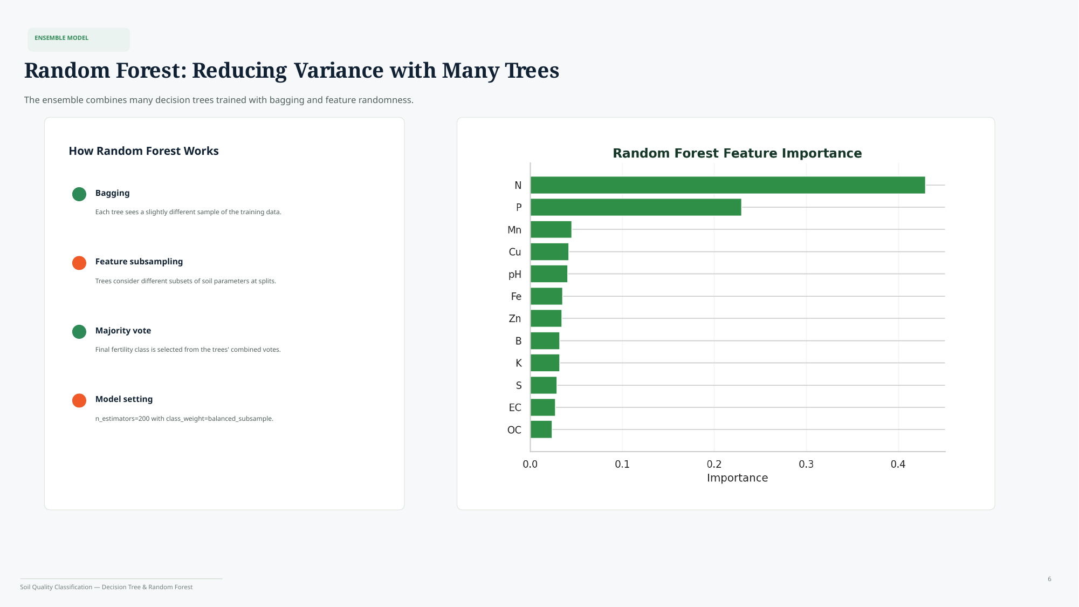
Notes:
Original slide 6 preserved as provided. Present this slide first, then use the following explanation slide as your speaking support.

Slide 12
Slide 6 — Explanation
Random Forest Explanation
Reference slide kept unchanged
Random Forest improves stability by combining many different Decision Trees.
• Bagging: each tree trains on a slightly different sample of the training data.
• Feature subsampling: different trees consider different soil parameters at splits.
• Majority vote: the final class is selected from the combined tree votes.
Quick structure to speak
1. State the purpose
2. Explain the method
3. Justify why it fits
4. Mention the limitation
Say this in viva / presentation
“Random Forest reduces variance, so it is usually more stable than one Decision Tree.”
Tip: Do not just read the slide. Use the slide as proof, then explain the reasoning in your own words.
Notes:
Say that a single tree can be sensitive to small changes in training data. Random Forest solves this by training many trees with randomness. Bagging changes the rows each tree sees, and feature subsampling changes the columns considered at splits. The final output is decided by majority vote. In the feature importance chart, N and P have high importance, meaning they strongly influenced the learned decisions.

Slide 13
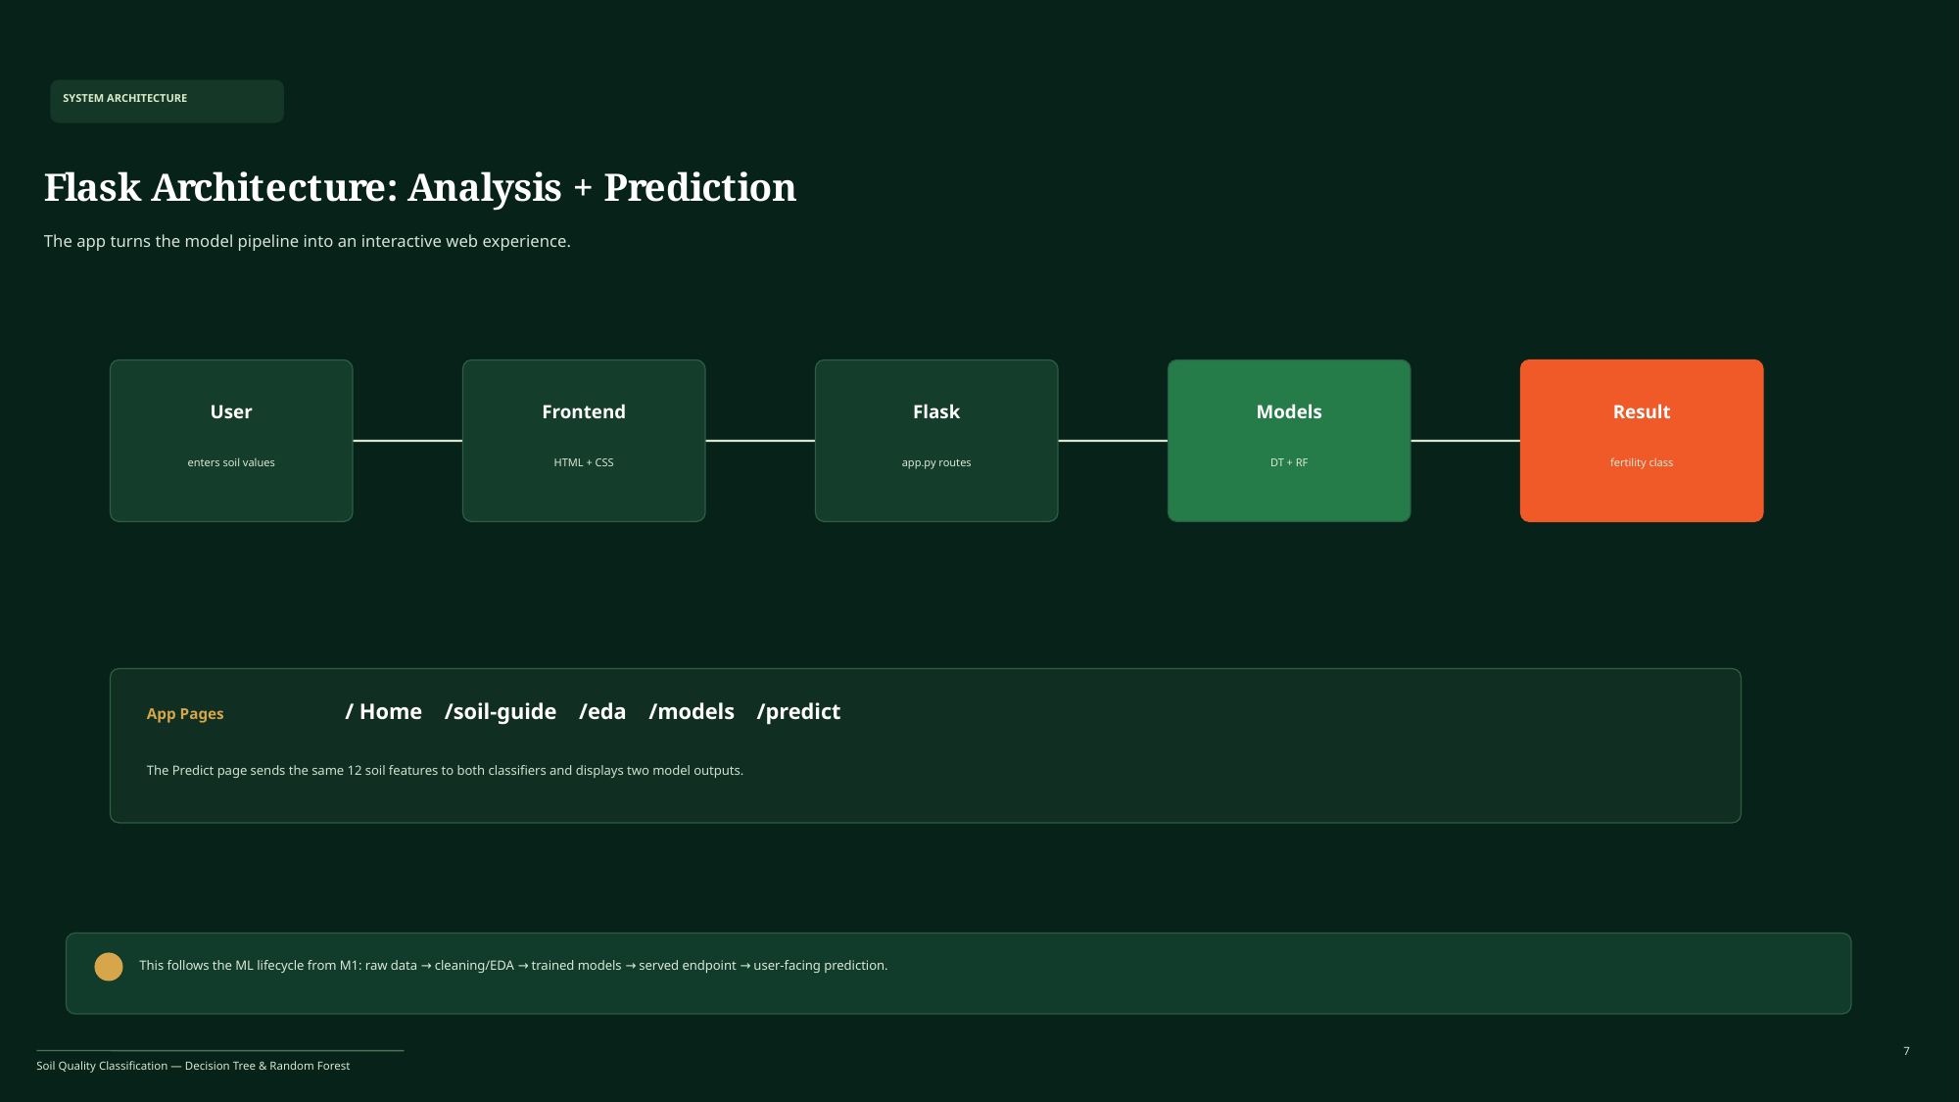
Notes:
Original slide 7 preserved as provided. Present this slide first, then use the following explanation slide as your speaking support.

Slide 14
Slide 7 — Explanation
Flask Architecture
Reference slide kept unchanged
The app converts the ML model into an interactive web experience.
• User enters the 12 soil values in the frontend form.
• Flask app.py receives the values and passes them to both trained classifiers.
• The Predict page displays two outputs: Decision Tree result and Random Forest result.
Quick structure to speak
1. State the purpose
2. Explain the method
3. Justify why it fits
4. Mention the limitation
Say this in viva / presentation
“This follows the lifecycle: trained model → served endpoint → user prediction.”
Tip: Do not just read the slide. Use the slide as proof, then explain the reasoning in your own words.
Notes:
Explain the flow: User to frontend, frontend to Flask route, Flask to models, model result back to the page. Mention the pages shown in the slide: home, soil guide, EDA, models, and predict. The same 12 features are supplied to both classifiers so the user can compare their predicted fertility class.

Slide 15
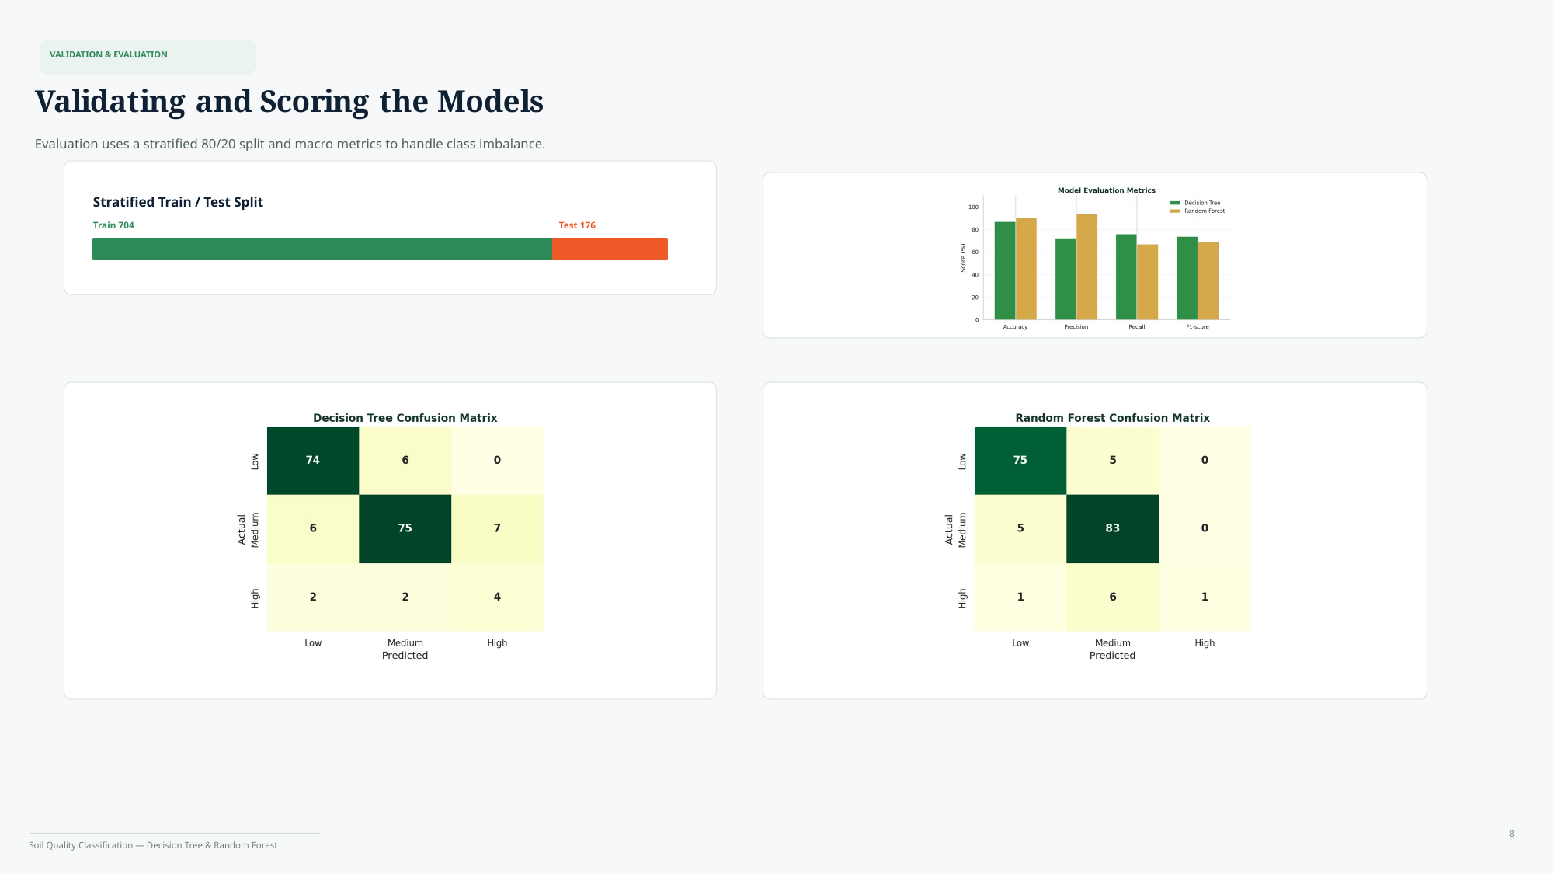
Notes:
Original slide 8 preserved as provided. Present this slide first, then use the following explanation slide as your speaking support.

Slide 16
Slide 8 — Explanation
Validation + Evaluation
Reference slide kept unchanged
Evaluation uses both global metrics and class-level error analysis.
• Train-test split: 704 training samples and 176 testing samples.
• Macro precision, recall and F1 are important because the classes are imbalanced.
• Confusion matrices show exactly where Low, Medium and High samples are misclassified.
Quick structure to speak
1. State the purpose
2. Explain the method
3. Justify why it fits
4. Mention the limitation
Say this in viva / presentation
“Because High Fertility is rare, I did not depend only on accuracy.”
Tip: Do not just read the slide. Use the slide as proof, then explain the reasoning in your own words.
Notes:
Explain that accuracy tells how many predictions were correct overall, but can hide poor minority-class performance. Precision answers: when the model predicts a class, how often is it correct? Recall answers: out of the actual samples in a class, how many did the model find? F1 balances precision and recall. Confusion matrices help us inspect which class gets confused with which other class.

Slide 17
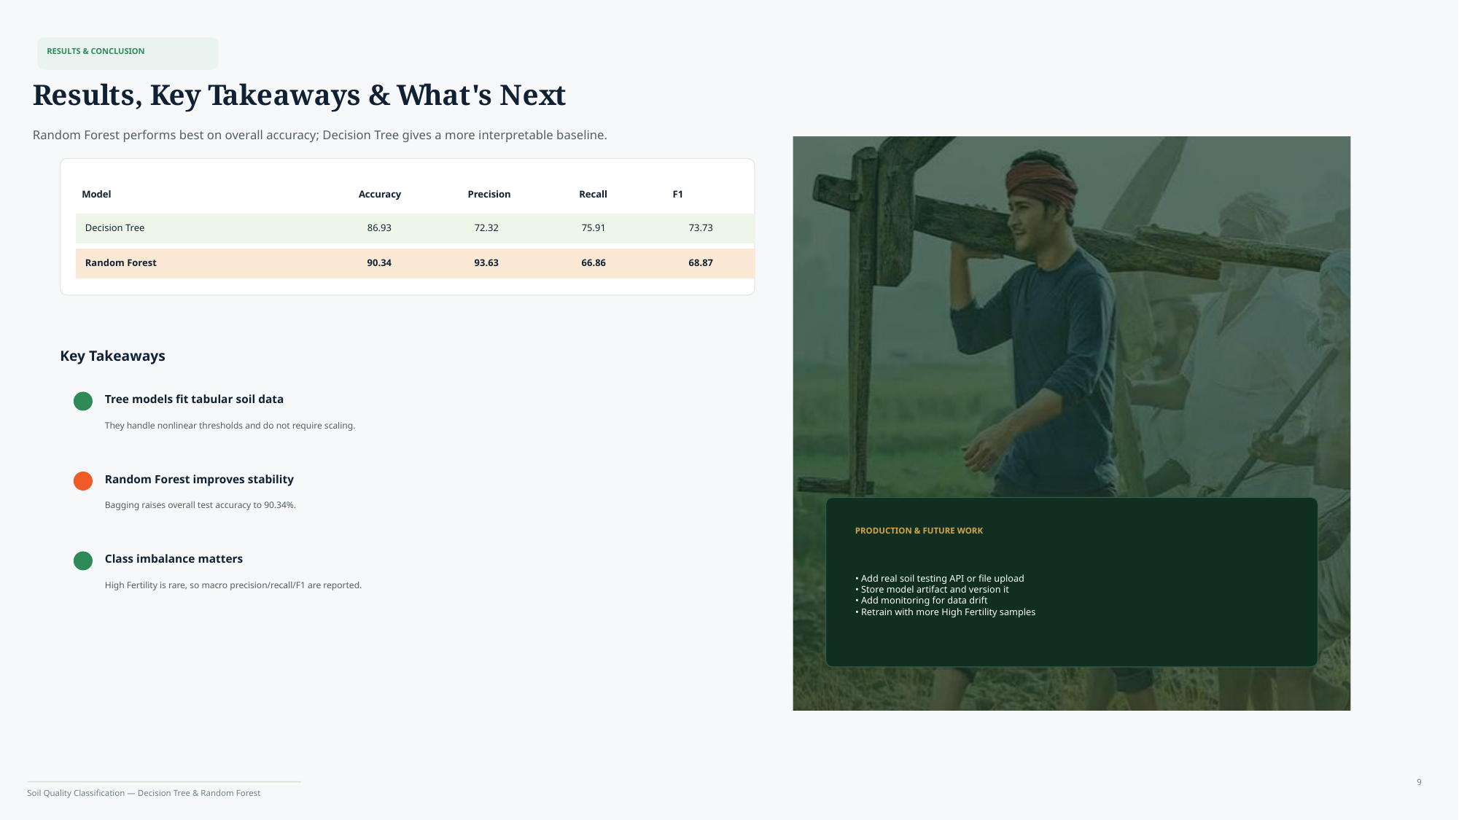
Notes:
Original slide 9 preserved as provided. Present this slide first, then use the following explanation slide as your speaking support.

Slide 18
Slide 9 — Explanation
Results + Conclusion
Reference slide kept unchanged
The final result is not just “which model won”; it is a trade-off analysis.
• Random Forest gives higher overall accuracy: 90.34% compared with 86.93% for Decision Tree.
• Decision Tree remains valuable because it is easier to explain and has stronger macro recall/F1 in the shown table.
• Future work: model artifact versioning, drift monitoring, file/API input and more High Fertility samples.
Quick structure to speak
1. State the purpose
2. Explain the method
3. Justify why it fits
4. Mention the limitation
Say this in viva / presentation
“Random Forest is stronger overall, but Decision Tree is better for interpretability.”
Tip: Do not just read the slide. Use the slide as proof, then explain the reasoning in your own words.
Notes:
Conclude by saying that tree-based models fit this tabular soil dataset because they handle nonlinear threshold rules and do not require scaling. Random Forest improves stability through bagging and achieves the best accuracy. However, the minority High class is still the main limitation, so future work should collect more High Fertility samples, monitor data drift, store versioned model artifacts, and allow file/API input in production.

